Slide 1
Predicting Margin of Victory in the NFL
Capstone Project by Dylan Wilkerson

Slide 2
Introduction
Set lines for a randomly created week in the NFL season
Use solver to create reference ratings, then utilize machine learning to create predictive models
Dependent variable = margin of victory
Model output will give us two ratings, offensive and defensive
These ratings will be used to create the lines

Slide 3
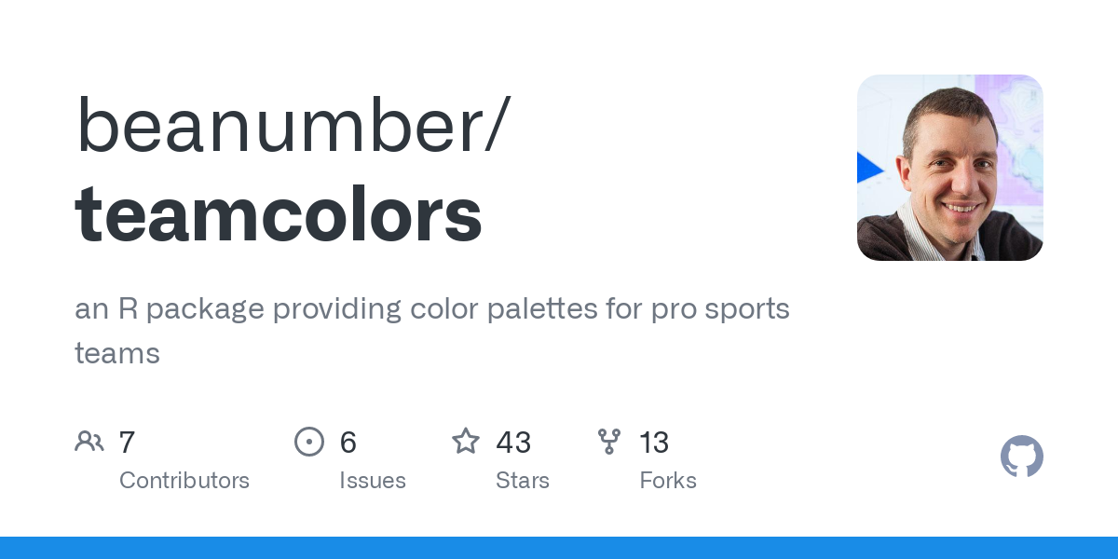
Data and Tools
Preliminary offensive and defensive data was used from profootballreference.com and stathead.com
Sports betting data from legalsportsreport.com
Initial team ratings were created using the solver function in Excel
The “teamcolors” library was used to get team logos for plots
Game by Game data from stathead.com
Educational content from Mathletics by Wayne L. Winston

Slide 4
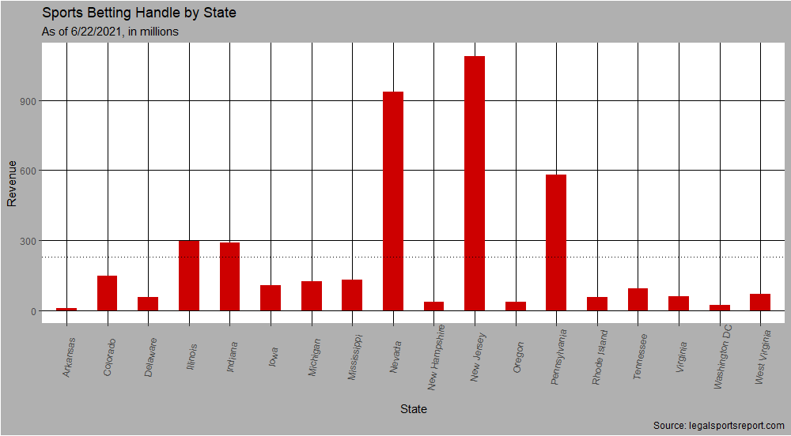
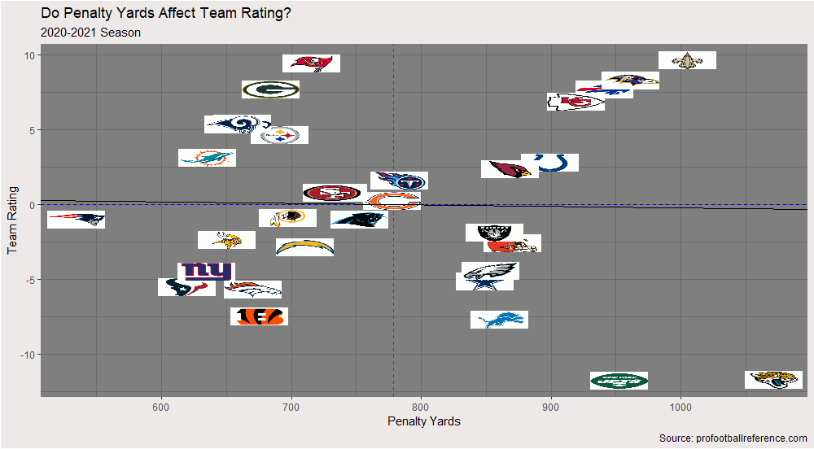
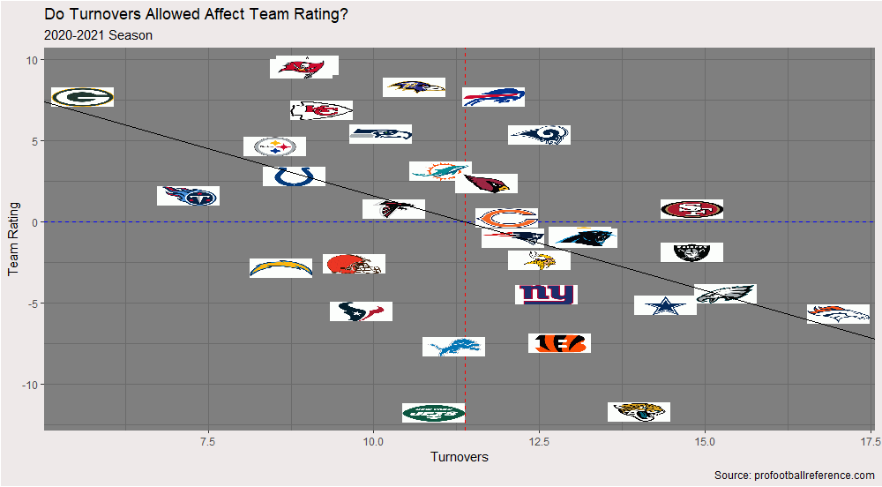
Descriptive Analysis
Although I am trying to revise the current rating system, the current team ratings still provide a picture of a teams ability
This gives me a good idea as to what variables I should select to create a predictive model

Slide 5




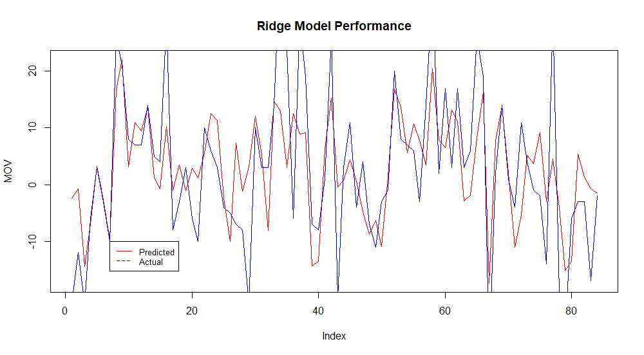

Predictive Analysis- Offense
Lasso
Stats used for offensive model are pass attempts, quarterback rating, third down and fourth down conversions, and total yards.
Ridge model is the best fit
Ridge
Elastic Net
OLS

Slide 6




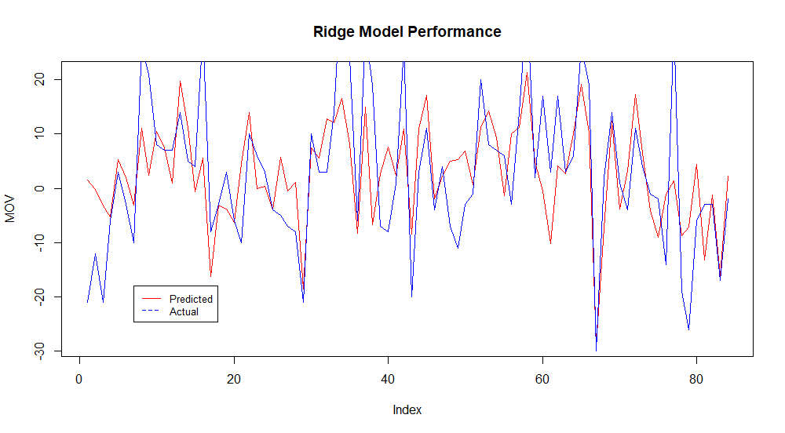

Predictive Analysis- Defense
Lasso
Stats used for defensive model are points allowed, defensive plays, and average defensive yards per play.
Ridge model again, is the best model.
Ridge
Elastic Net
OLS

Slide 7
Prescriptive Analysis
We have our model, now what?
Pull each team’s season average for the stats used in the model to create an offensive and defensive rating for each team.
Home field advantage in 2020, which is the difference in the average offensive and defensive rating
By using the offensive rating for the home team, we account for the home field advantage.
We have a new equation for MOV:
MOV = Home Team’s O Rating – Away Team’s D Rating

Slide 8
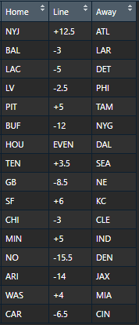
Prescriptive Analysis- CONT.
Using Solver
Revised Lines

